Slide 1
FY25 Year End BAPCO Budget Slides

Slide 2
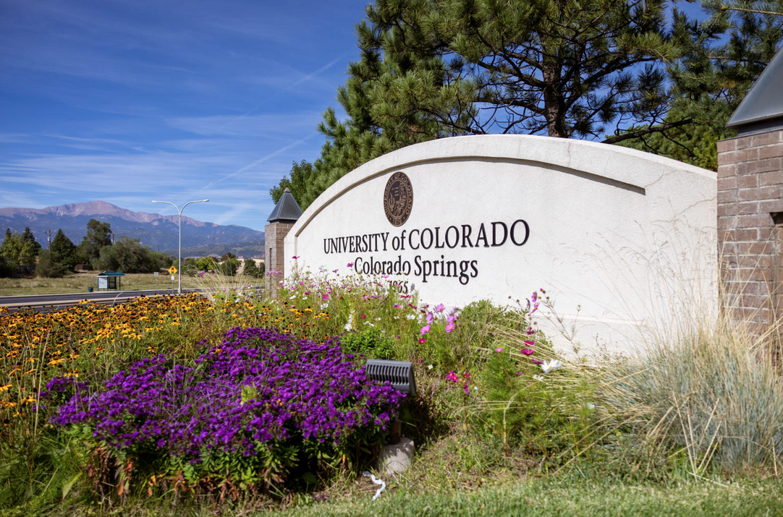
Speedtype Clean Up
What does it mean to clean up a speedtype? In a nutshell, match budget to actuals.
Pay close attention to revenue and transfer budgets and match them to the exact account code. These accounts must not have a balance at year end.
Match salary account codes to position numbers.
For expenses, travel, student aid, etc - Clean up needs to be by account code rollup.
Approval of Year End BJEs are more efficient when line descriptions are descriptive.
Please attach the appropriate supporting documents.
Examples: Tracking spreadsheets, emails, and Operating Summary Reports
Shorter BJEs are approved faster with less confusion and questions.
Departments will be able to complete BJEs through second close, 7/14/2025 by 4:00pm. Afterwards, if any adjustments are necessary, please notify the Budget Office.
Between the second and third close, only the Budget Office will have access to the Budget Ledgers.
Notes:
Colorado Legislature determines tuition increases before approval by BOR.

Slide 3
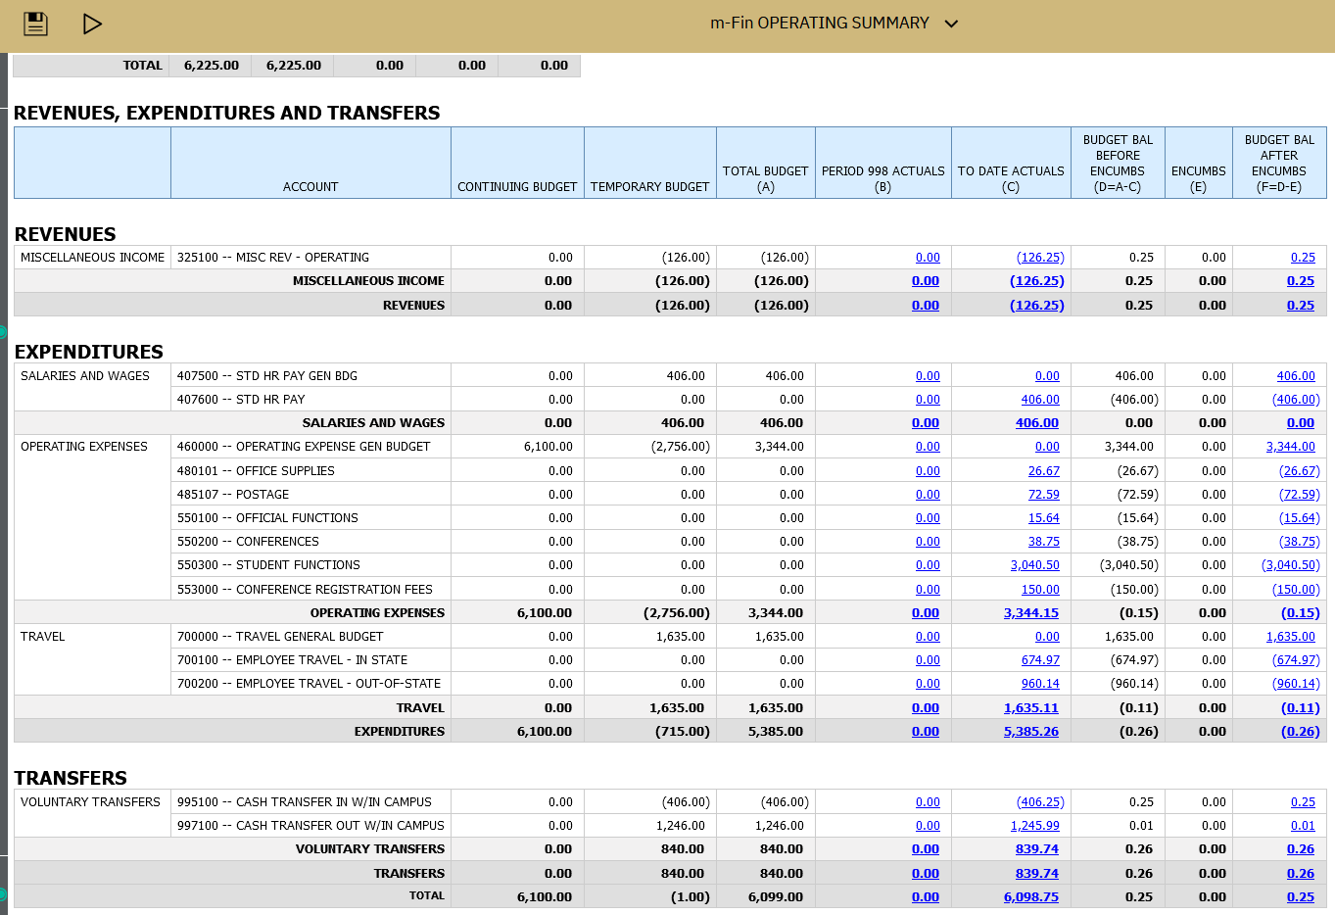
EXAMPLE OF SPEEDTYPE THAT HAS BEEN “CLEANED UP”
Notes:
Colorado Legislature determines tuition increases before approval by BOR.

Slide 4
Cash Transfer to Reserves
What balances should be moved to reserves?
Same as last year end, outstanding budget balances of $10,000 or more should be moved to reserves.
When moving unspent base budget in excess of 10k, please move the entire amount and not just enough to get below the 10k threshold.
You may keep temp funded ST balances on the ledgers, e.g. F&A amounts and faculty award STs.
Remember, a BJE to transfer to reserves is necessary to go along with the ACTUALS cash transfer journal entry.
The BJE and the JE may be completed simultaneously. Please attach the print version to the BJE and/or JE even if it does not have an “Approved by” yet.
Tip: when moving balances to Fund 72s, have a plan for its use. This will make spending plan templates easier to complete.

Slide 5
Carryforward
Carryforward is the amount of balance left in the speedtype at year end.
The balance will come back as temporary funds next fiscal year.
No matter where the balance originated, the funds will carryforward to account code 460000.
All Carryforward funds must first be approved by Chancellor’s Cabinet. After their approval, the Budget Office completes the BJE.
To utilize balances immediately the next fiscal year, it is best to transfer balances to your Fund 72s.
Transferring balances to reserves at year end will give access to those funds as soon as the ledgers open for the new fiscal year.
Leaving budget balances on the books at year end, will cause a delay in a department’s ability to use those funds next fiscal year.

Slide 6
Best Practices
Please include detailed descriptions in your line descriptions and the long description.
Attach appropriate supporting documents.
The 14 line BJE limit still remains. The longer the BJE, the more likely the Budget office will be to contact you for clarification. We look at every line. One mistake will delay the clean up of many speed types in a longer entry.
Start your Year End clean up now. To minimize stress and mistakes from being rushed, let’s start early.
When completing a cash transfer, it is acceptable to submit both the actuals JE and the BJE at the same time. Please attach the “print version” of the JE to the BJE.
Start by cleaning up positions. Everything else is easy after this. Next, clean up by account, then make your cash transfers to reserves.
Notes:
Estimate based on actual head count enrolled in what SCH. Tuition and Enrollment is projected from both HC and SCH. We need to be clear that we do consider SCH because there is a misnomer out there that we only consider HC. System likes us to report HC, but we project off of previous Fall SCH.

