Slide 1
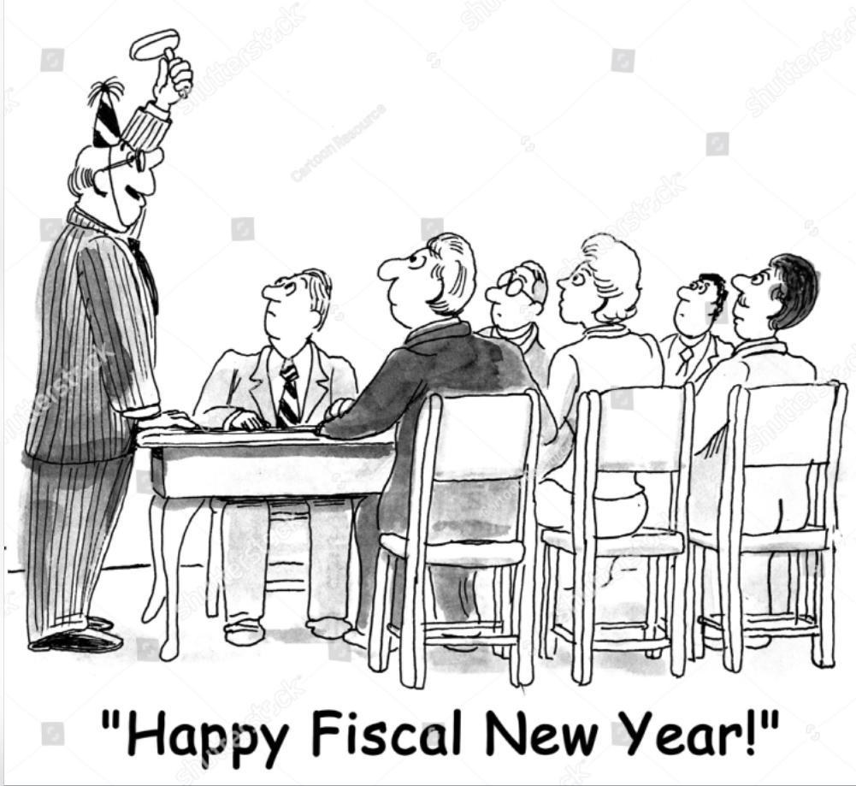
YEAR-END CLOSE MEETING May 28, 2025

Slide 2
Agenda
Introduce Presenters
PSC Presentation
UCCS Presentation

Slide 3
Presenters
Sophia Lueth – PSC, Director of Payment Services
Terri Wagner– UCCS, Director of Campus Budget Operations
Nick Martinez – UCCS, Deputy Controller

Slide 4
Procurement Service Center (PSC)
Sophia Lueth
PSC, Director of Payment Services

Slide 5
Fiscal Year-End 2025
Procurement Service Center (PSC) Deadlines

Slide 6
Today’s Agenda
PSC FYE Deadlines
Purchasing
Supplier Support
Payable Services
Travel/Reimbursement
Procurement Card
PSC Systems
Accruals
Reminders
FY26 Activity
Encumbrances
If a deadline is missed, continue to send documents to PSC. PSC will continue to process after published deadlines but cannot guarantee payment/posting will occur by FYE.

Slide 7
FYE 2025 – Purchasing Deadlines
February 1, 2025
Last day to submit REQUESTS FOR PROPOSALS ($500,000 and up) to ensure the order is processed and paid using FY25 funds
March 1, 2025
Last day to submit for DOCUMENTED QUOTES ($150,000 to $499,999) to ensure the order is processed and paid using FY25 funds
May 1, 2025
Last day to submit requisitions with contracts and/or supplier terms and conditions to ensure the order is processed and paid using FY25 funds (security and compliance reviews must be completed, suppliers must be responsive)
Thursday, May 15, 2025
Last day to submit requisitions without contracts and/or supplier terms and conditions to ensure the order is processed and paid using FY25 funds
Last day to submit change orders for increases or data change that result in contract amendment
Las day to submit small dollar contract requests

Slide 8
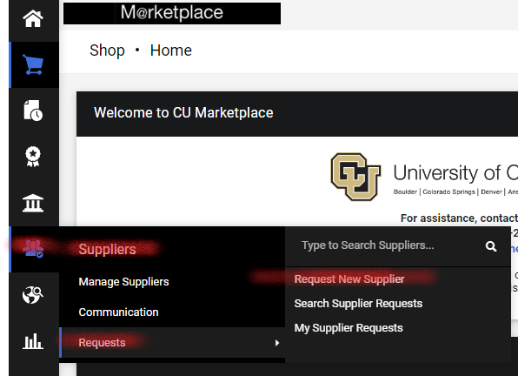
FYE 2025 – Supplier Support Deadlines
Friday, June 13, 2025 (deadline at 6pm)
Last day to submit information to:
Request a new supplier set-up
Use “Request New Supplier” form in CU Marketplace
Update an existing supplier record
Suppliers are encouraged to update their own records through the CU Marketplace self-service portal
Address changes can be sent to CUSupplier@cu.edu

Slide 9
FYE 2025 – Payable Services Deadlines
Friday, June 13, 2025 (deadline at 6pm)
To ensure payment in FY25
Last day to submit all “paper” forms:
Payment Authorization (PA) form
Study Subject Payment (SSP) form
Non-Employee Reimbursement-International (NRI) form
Submit forms to APInvoice@cu.edu
Include all required documentation/attachments
Fill out forms completely, including ALL signatures
Include W-9/W-8 form when submitting for payment, if applicable

Slide 10
FYE 2025 – Payable Services Deadlines
Friday, June 13, 2025 (deadline at 6pm)
To ensure payment in FY25
Last day to submit PO/SPO/BPO Invoices
Send to APInvoice@cu.edu
Payments are subject to payment terms (typically N30)
Last day to provide campus approval for Payment Vouchers in CU Marketplace (N00)
CU Marketplace invoice/voucher payments are included in the accrual process

Slide 11
FYE 2025 – Payable Services Guidelines
Submit clear and legible documents
Include all required documentation/signatures (SOW form(s), Honorarium, etc.)
Invoices must include PO number on the document
Processing is completed first-in/first-out
Remember to check payment status FIRST
Look up in the system or contact the PSC Service Desk
Refrain from sending in duplicate copies of invoices to APInvoice
Backlogs the system and creates longer processing times

Slide 12
FYE 2025 – Payable Services Deadlines
Monday, June 30, 2025 (deadline at 12pm)
Last day to submit requests to cancel AP checks
Submit Warrant Adjustment (WA) form to PSC at APInvoice@cu.edu
Ensure WA form is fully completed and fully signed

Slide 13
FYE 2025 – Travel & Reimbursement Deadlines
Friday, June 13, 2025 (deadline at 6pm)
To ensure reconciliation/payment in FY25
Last day to provide campus approval for:
Employee Travel Reconciliation (expense) reports
Employee Non-Travel Expenses reports
Non-Employee Expenses reports
Travel & Reimbursement reports/payments ARE NOT accrued

Slide 14
FYE 2025 – Procurement Card Deadlines
Friday, June 20, 2025 (deadline at 6pm)
To ensure reconciliation in FY25
Last day to provide campus approval for Procurement Card reports
Procurement Card transactions incurred by 6/30/25 will be accrued

Slide 15
FYE 2025 – PSC System Deadlines
Friday, June 13, 2025 (deadline at 6pm)
To ensure reconciliation in FY25
Last day to close Purchase Orders so they do not automatically roll-forward to FY26
Last day to add money to SPO/BPOs so they will roll-forward to be used in FY26
SPOs must have at least a $1 available balance to roll-forward
Send requests to ChangeOrder@cu.edu

Slide 16
FYE 2025 – Payable Services Activity after June 30 PO/SPO Invoice Accruals
Wednesday, July 2, 2025 (deadline at 12pm)
PO/SPO invoices sent to PSC by noon on July 2 will be processed (input into the system) and accrued
Submit invoices to APInvoice@cu.edu
Does not need to pay in order to be accrued for FY25 business
Invoices for FY26 business should NOT be sent to the PSC until Monday, July 7, 2025 or later

Slide 17
FYE 2025 – Payable Services Activity after June 30 Payment Voucher Accruals
Wednesday, July 2, 2025 (deadline at 6pm)
Last day to provide campus approval for Payment Vouchers in CU Marketplace
PV will be in the AP Form Review workflow step in CU Marketplace
Must be fully approved by all department fiscal/specialized approvers
Must include all required documentation/signatures
Will be considered FY25 business and accrued

Slide 18
FYE 2025 – Other Activity after June 30 Procurement Card Accruals
Wednesday, July 2, 2025 (deadline at 6pm)
Last day to allocate Procurement Card transactions in Concur for accrual – for transactions dated June 30th or prior
SpeedType accrual:
Transactions assigned to an expense report and allocated to a SpeedType – accrued to allocated SpeedType
Transactions assigned to an expense report but not allocated to a SpeedType – accrued to default SpeedType
Transactions not assigned to an expense report – accrued to default SpeedType
Account accrual:
Transactions assigned (or defaulted) to an expense type in an expense report – accrued to that expense type’s mapped account code
If transaction is not assigned and no default expense type populates in Concur – accrued to account code 552601 (Other Operating Supplies)

Slide 19
FYE 2025 – Reminders – No Accruals
Received but No Invoice
The PSC will not generate an accrual for items received but not invoiced
Paper Forms (PA, SSP, & NRI)
The PSC will not accrue payments processed on these forms
Follow the June 13, 2025 (6pm) deadline for payment and posting of FY25 form payments
Travel & Reimbursement Expense Reports
The PSC will not generate an accrual for travel and reimbursement expense reports
Follow the June 13, 2025 (6pm) deadline for campus approval of Concur Travel, Employee Non-Travel and Non-Employee expense reports

Slide 20
FYE 2025 – Accruals
Procurement Card Accruals (ACCESP)
Will run on Thursday, July 10, 2025
Visible on reports by Friday, July 11, 2025
Invoice Accruals (ACCAPMKT)
Will run on Thursday, July 10, 2025
Visible on reports by Friday, July 11, 2025

Slide 21
FYE 2025 – Reminders
FY26 Activity
Do NOT send invoices/payment forms for FY26 processing until July 7, 2025 or after
PO/SPO Invoices received through July 2 at 12pm will be considered June business for FY25
If a PO is partially invoiced and no further invoices are expected – please send request to close the PO to ChangeOrder@cu.edu

Slide 22
FYE 2025 – More Reminders
Encumbrances
Must have a balance remaining on PO/SPO/BPO to use in FY26
PO/SPO/BPO encumbrances roll forward to July (period 1 of FY26) on June 30
June statements run on July 1 and after will no longer show encumbrances
POs created in June will show encumbrances on reports through June 30

Slide 23
If a deadline is missed, continue to send documents to the PSC. The PSC will continue to process after published deadlines but cannot guarantee payment/posting will occur by FYE.

Slide 24
Recent Items
CU Efficiency Awards
Top 10 to present videos May 22nd, expo in Fall 25
FY26 Endowment Distribution
July 1st as planned
(per CUF website)
Thanks for your continued support!

Slide 25
Calendars/Websites
OUC FYE page with FY25 INFO.
https://www.cu.edu/controller/accounting-finance/fy-2025-year-end-processing-and-deadlines
Original YE Calendar
UCCS Controller’s Office page
https://vcaf.uccs.edu/units/controllers-office/year-end
YE Calendar
PPT slides
Accrual Information (Deadlines, How to, and Examples)
Understanding PO Encumbrances

Slide 26
FY25 Year-End Close Dates
First
Close
Thursday, July 3
Period 12
Second Close
Monday, July 14 Period 996
Final Campus Close Monday, July 21 Period 997
Note: Friday, July 4, 2025, campus closed in observance of Independence Day.

Slide 27
User Alert
No journals (FY25) approved or manually posted (New fiscal year exemption)
Monday, July 7th
Tuesday, July 15th
Tuesday, July 22nd
Journals
Journals
Journals

Slide 28
Upcoming Dates
Monday, May 26th
Memorial Day Holiday
Monday, June 2nd
Spring Semester ePERs are generated
Monday, June 2nd
Moratorium on Chartfield requests (STs, orgs, reorgs, updates)
Monday, June 30th
Bursar would like your cash/check drop off by 3:00 pm
The cash window will close at 4:00 pm
Monday, June 30th
Goods and services must be physically received by this date to be accounted for in FY25
Wednesday, July 3rd
Bad Debt adjustment as of 06/30 to post to GL
Notes:
BAD DEBT ADJUSTMENT WILL OCCUR ON 07/01 POSTING 07/02

Slide 29
Fiscal Certification Dates
Monday, May 5th
Updated Fiscal Cert sent to CCO from campus units after review
Friday, May 30th
Fiscal Cert review due back to OUC
Monday, June 2nd
Officers & delegates set due dates
Monday, June 30th
Fiscal Cert close for due dates
Tuesday, July 1st
Fiscal Cert commences

Slide 30
Budget and Planning Office
Terri Wagner
UCCS, Director of Campus Budget Operations

Slide 31
FY25 Year End BAPCO Budget Slides

Slide 32
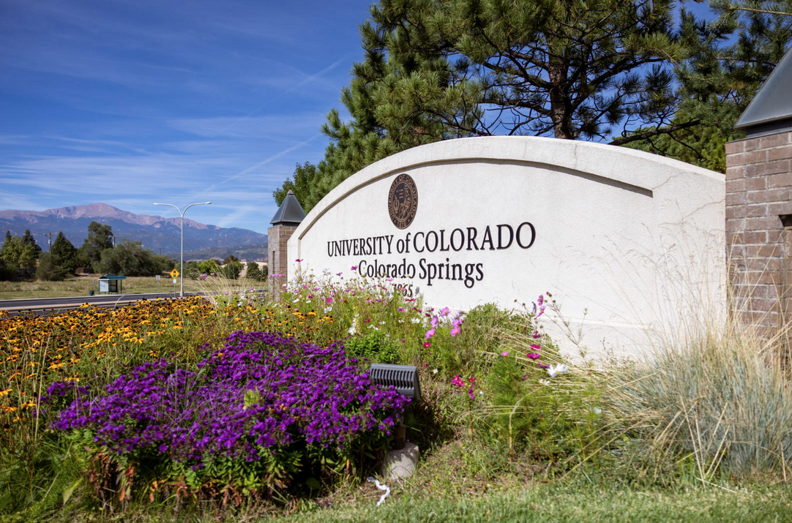
Speedtype Clean Up
What does it mean to clean up a speedtype? In a nutshell, match budget to actuals.
Pay close attention to revenue and transfer budgets and match them to the exact account code. These accounts must not have a balance at year end.
Match salary account codes to position numbers.
For expenses, travel, student aid, etc - Clean up needs to be by account code rollup.
Approval of Year End BJEs are more efficient when line descriptions are descriptive.
Please attach the appropriate supporting documents.
Examples: Tracking spreadsheets, emails, and Operating Summary Reports
Shorter BJEs are approved faster with less confusion and questions.
Departments will be able to complete BJEs through second close, 7/14/2025 by 4:00pm. Afterwards, if any adjustments are necessary, please notify the Budget Office.
Between the second and third close, only the Budget Office will have access to the Budget Ledgers.
Notes:
Colorado Legislature determines tuition increases before approval by BOR.

Slide 33
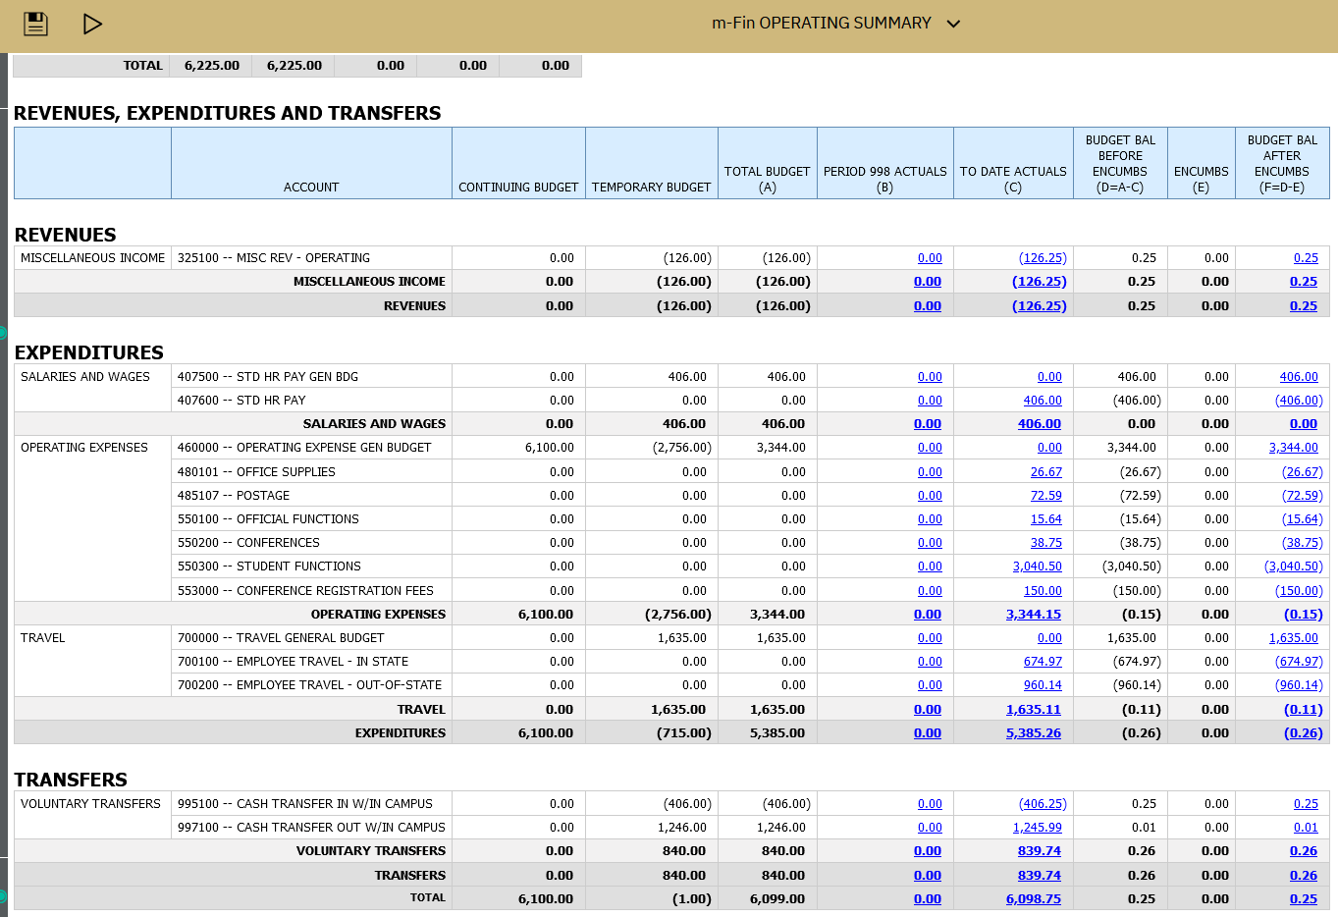
EXAMPLE OF SPEEDTYPE THAT HAS BEEN “CLEANED UP”
Notes:
Colorado Legislature determines tuition increases before approval by BOR.

Slide 34
Cash Transfer to Reserves
What balances should be moved to reserves?
Same as last year end, outstanding budget balances of $10,000 or more should be moved to reserves.
When moving unspent base budget in excess of 10k, please move the entire amount and not just enough to get below the 10k threshold.
You may keep temp funded ST balances on the ledgers, e.g. F&A amounts and faculty award STs.
Remember, a BJE to transfer to reserves is necessary to go along with the ACTUALS cash transfer journal entry.
The BJE and the JE may be completed simultaneously. Please attach the print version to the BJE and/or JE even if it does not have an “Approved by” yet.
Tip: when moving balances to Fund 72s, have a plan for its use. This will make spending plan templates easier to complete.

Slide 35
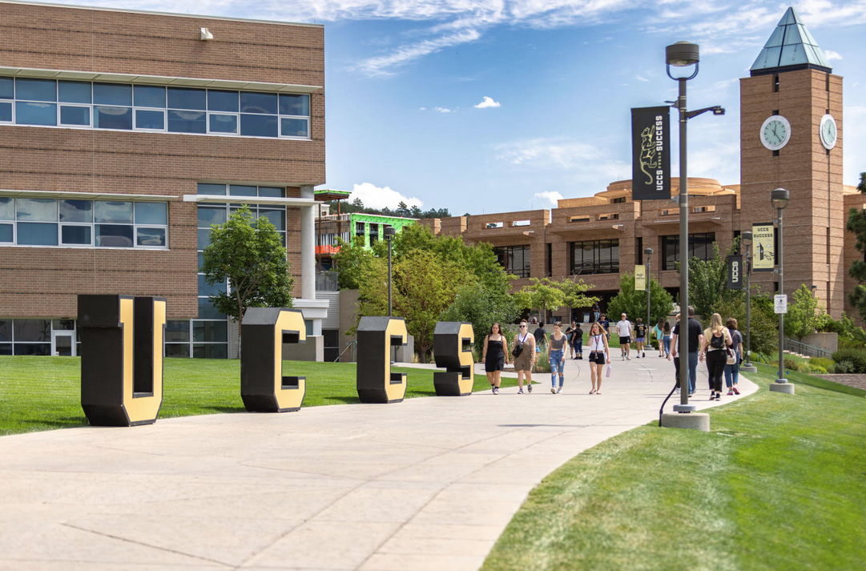
Carryforward
Carryforward is the amount of balance left in the speedtype at year end.
The balance will come back as temporary funds next fiscal year.
No matter where the balance originated, the funds will carryforward to account code 460000.
All Carryforward funds must first be approved by Chancellor’s Cabinet. After their approval, the Budget Office completes the BJE.
To utilize balances immediately the next fiscal year, it is best to transfer balances to your Fund 72s.
Transferring balances to reserves at year end will give access to those funds as soon as the ledgers open for the new fiscal year.
Leaving budget balances on the books at year end, will cause a delay in a department’s ability to use those funds next fiscal year.

Slide 36
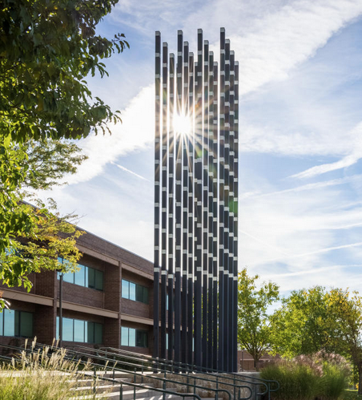
Best Practices
Please include detailed descriptions in your line descriptions and the long description.
Attach appropriate supporting documents.
The 14 line BJE limit still remains. The longer the BJE, the more likely the Budget office will be to contact you for clarification. We look at every line. One mistake will delay the clean up of many speed types in a longer entry.
Start your Year End clean up now. To minimize stress and mistakes from being rushed, let’s start early.
When completing a cash transfer, it is acceptable to submit both the actuals JE and the BJE at the same time. Please attach the “print version” of the JE to the BJE.
Start by cleaning up positions. Everything else is easy after this. Next, clean up by account, then make your cash transfers to reserves.
Notes:
Estimate based on actual head count enrolled in what SCH. Tuition and Enrollment is projected from both HC and SCH. We need to be clear that we do consider SCH because there is a misnomer out there that we only consider HC. System likes us to report HC, but we project off of previous Fall SCH.

Slide 37
HR Dates for June
Thursday, June 12th
5 pm approval deadline for Position Data, Funding, and Job Data (BW 6/7)
Friday, June 20th
Run Payroll Register Report – MON PPE 6/30 (Review Summer Funding distributions)
Friday, June 20th
HR Encumbrances: Should be zero for General Fund
Thursday, June 26th
5pm approval deadline for Position Data, Funding, and Job Data (BW 6/21)
Thursday, June 26th
5 pm deadline to upload and approve time for (BW 6/21)
Friday, June 27th
Position Funding rollover

Slide 38
HR Dates for July-FY24
Tuesday, July 1st
OUC to book payroll accrual and reversal for BW PPE 6/21, pays 7/3.
Thursday, July 3rd
OUC to book payroll accrual and reversal for OC 06/26, pays 7/3
Thursday, July 10th
OUC to book payroll accrual and reversal for OC 07/03, pays 7/11
Monday, July 14th
OUC to book the payroll accrual and reversal for BW PPE 7/5, pays 7/18 (NOTE: Campus last day to submit journals)
Friday, July 18th
FY25 PETs must be entered/approved by 6pm (BEWARE: General Fund PETs will impact budgets and budget ledger is closed)

Slide 39
Important UCCS Dates
Monday, June 2nd
Last day to submit AR write-offs to CCO.
Friday, June 6th
Request work-study payroll transfer requests. Review expenditures and setup, incorrect setups will be charged to depts.
Monday, June 30th
Physical inventory of consumable goods, greater than $35K must be completed. Adjust balance to reflect on hand inventory by 7/3. Submit inventory reconciliation to acctfinc@uccs.edu
Notes:
CCO (Campus Controller’s Office)

Slide 40
Important UCCS Dates
Thursday, July 3rd
Record accruals for cash on hand if not deposited with Bursar by 3 pm 6/30. 000600 – Deposits in Transit. Reverse in following FY when processed by Bursar.
Record Unearned Revenue in account 150200. Submit reconciliation to acctfinc@uccs.edu.
Notify acctfinc@uccs.edu of uncollected payroll overpayments 6/30 year-end.
Submit a GIK Acceptance Form to acctfinc@uccs.edu for non-cash gifts valued at $5K or more.

Slide 41
Important UCCS Dates
Thursday, July 3rd (cont.)
Record prepaid expenses for payments of $10K or more.
Review deposits held in custody account 150400, ensure detail by depositor supports the balances. Submit reconciliation to acctfinc@uccs.edu
Record, review, and reconcile Accounts Receivable. Do not use LOC or BRS accounts. Verify customer detail ties to GL balance.
Review TBS for abnormal balances.

Slide 42
Items to clean up
Review & Reconcile your ST’s
Resolve deficits
Company Card Personal Charges
Account 013109
Run m-Fin Account Number Report by your Orgs
Company Card Unallowable Expenses
Account 553201
Run m-Fin Account Number Report by your Orgs
Payroll Suspense should be cleared
Account 410100
Clearing STs & Accounts
Need to be reconciled

Slide 43
To Do List…
Review asset accounts for abnormal balances: Ensure all the asset accounts (except allowance for doubtful accounts) in the general fund, auxiliary, gift fund, and the renewal and replacement plant funds have a normal debit (positive) balance.
Review liability accounts for abnormal balances: Ensure all the liability accounts in the general, auxiliary, gift fund, and renewal and replacement plant funds have a normal credit (negative) balance.
Review asset and liability accounts for unchanged balances. Pull a Trial Balance Summary for your STs for period 1 to 12, review for accounts with no activity or unchanged balance from 07/01 to 06/30. Adjust balance as necessary with documentation for adjustment.
Reconcile your SpeedTypes to ensure all expected transactions have posted. Review for completeness and accurately. Resolve any existing or anticipated deficits.
Review all transactions within the SpeedType ensuring they belong to that program or project, pay close attention to expenses.
Ensure each transaction has appropriate back-up documentation.
Review all SpeedTypes for cash or budget deficits. When identified, do you anticipate a deficit by the end of the fiscal year? If so, how will the deficit be remedied?

Slide 44
Things to Do Closer to June
Record all amounts owed to the department by external entities as an accounts receivable. Reconcile accounts receivable customer detail to the amounts in the Finance System.
Submit Payment Authorization to reimburse petty cash funds and record all petty cash purchases made in current FY in the Finance System.
Review funding distributions on both monthly and biweekly employees to be sure that pay information is correct so that payroll suspense will be avoided.

Slide 45
Important Reminder
Interdepartmental (ID) Sales
Goods/Services must be received by 06/30 to record. May not be accrued as AR or AP.

Slide 46
Sponsored Project YE Deadlines
Please have all year end activities completed by the first close, 7/3/2025
Cost Transfers
Deficits
Accruals
PETs
Purchasing continues as usual
Note PSC deadlines
No “pause” on sponsored projects during YE
Notes:
Processing and cleaning up these items by first close will facilitate accurate and timely invoicing by Sponsored Projects Accounting.

Slide 47
Bursar Office Fiscal Year-End Timeline
• Thursday, June 25, 2025
Turn off / Inactivate at 4:30PM: (effective 6/26 – 6/30)
SFS_REFUND_SPONSER (Check Refunds)
SFS_REFUND_STUD_WAR (Demand Warrants)
SFS_REFUND_ACH (Direct Deposit Refunds)
Monday, June 30, 2025
Bursar Cashier Office closed for business at 4:00PM (Student payments; departmental payments)
UCCS Nelnet Maintenance Page: (Prevents access to student QuikPay account)
Inactivate at 6:00PM
Activate at 2:00AM July 1, 2025
GL Interface runs after Payment Applier has completed
Inactivate:
SFSU_TCALC_MF (Nightly Tuition Calculation (T-calc))

Slide 48
Upcoming Trainings
OUC – Office of the University Controller’s
Thursday, May 29, 2025
Fiscal Roles in Financial Systems and Reporting
Wednesday, June 11, 2025
Journal Entry Spreadsheets
Thursday, July 31, 2025
Red Flags Rules
UCCS Instructor Lead Training (EPC 239 & via MS Teams)
Finance Inquiry – May 30, 2025, 9:00 am
General Ledger – May 30, 2025, 1:00 pm

Slide 49
Any Questions?

