Slide 1
Fiscal Year-End 2025
Procurement Service Center (PSC) Deadlines

Slide 2
Today’s Agenda
PSC FYE Deadlines
Purchasing
Supplier Support
Payable Services
Travel/Reimbursement
Procurement Card
PSC Systems
Accruals
Reminders
FY26 Activity
Encumbrances
If a deadline is missed, continue to send documents to PSC. PSC will continue to process after published deadlines but cannot guarantee payment/posting will occur by FYE.

Slide 3
FYE 2025 – Purchasing Deadlines
February 1, 2025
Last day to submit REQUESTS FOR PROPOSALS ($500,000 and up) to ensure the order is processed and paid using FY25 funds
March 1, 2025
Last day to submit for DOCUMENTED QUOTES ($150,000 to $499,999) to ensure the order is processed and paid using FY25 funds
May 1, 2025
Last day to submit requisitions with contracts and/or supplier terms and conditions to ensure the order is processed and paid using FY25 funds (security and compliance reviews must be completed, suppliers must be responsive)
Thursday, May 15, 2025
Last day to submit requisitions without contracts and/or supplier terms and conditions to ensure the order is processed and paid using FY25 funds
Last day to submit change orders for increases or data change that result in contract amendment
Las day to submit small dollar contract requests

Slide 4
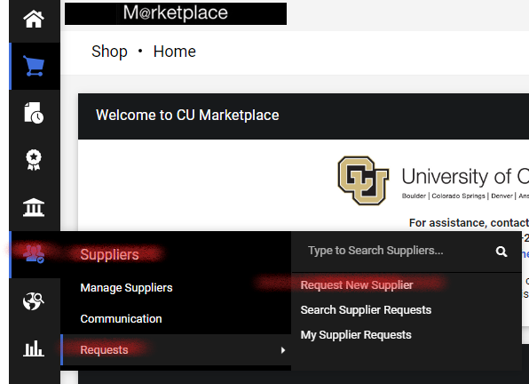
FYE 2025 – Supplier Support Deadlines
Friday, June 13, 2025 (deadline at 6pm)
Last day to submit information to:
Request a new supplier set-up
Use “Request New Supplier” form in CU Marketplace
Update an existing supplier record
Suppliers are encouraged to update their own records through the CU Marketplace self-service portal
Address changes can be sent to CUSupplier@cu.edu

Slide 5
FYE 2025 – Payable Services Deadlines
Friday, June 13, 2025 (deadline at 6pm)
To ensure payment in FY25
Last day to submit all “paper” forms:
Payment Authorization (PA) form
Study Subject Payment (SSP) form
Non-Employee Reimbursement-International (NRI) form
Submit forms to APInvoice@cu.edu
Include all required documentation/attachments
Fill out forms completely, including ALL signatures
Include W-9/W-8 form when submitting for payment, if applicable

Slide 6
FYE 2025 – Payable Services Deadlines
Friday, June 13, 2025 (deadline at 6pm)
To ensure payment in FY25
Last day to submit PO/SPO/BPO Invoices
Send to APInvoice@cu.edu
Payments are subject to payment terms (typically N30)
Last day to provide campus approval for Payment Vouchers in CU Marketplace (N00)
CU Marketplace invoice/voucher payments are included in the accrual process

Slide 7
FYE 2025 – Payable Services Deadlines
Monday, June 30, 2025 (deadline at 12pm)
Last day to submit requests to cancel AP checks
Submit Warrant Adjustment (WA) form to PSC at APInvoice@cu.edu
Ensure WA form is fully completed and fully signed

Slide 8
FYE 2025 – Payable Services Guidelines
Submit clear and legible documents
Include all required documentation/signatures (SOW form(s), Honorarium, etc.)
Invoices must include PO number on the document
Processing is completed first-in/first-out
Remember to check payment status FIRST
Look up in the system or contact the PSC Service Desk
Refrain from sending in duplicate copies of invoices to APInvoice
Backlogs the system and creates longer processing times

Slide 9
FYE 2025 – Travel & Reimbursement Deadlines
Friday, June 13, 2025 (deadline at 6pm)
To ensure reconciliation/payment in FY25
Last day to provide campus approval for:
Employee Travel Reconciliation (expense) reports
Employee Non-Travel Expenses reports
Non-Employee Expenses reports
Travel & Reimbursement reports/payments ARE NOT accrued

Slide 10
FYE 2025 – Procurement Card Deadlines
Friday, June 20, 2025 (deadline at 6pm)
To ensure reconciliation in FY25
Last day to provide campus approval for Procurement Card reports
Procurement Card transactions incurred by 6/30/25 will be accrued

Slide 11
FYE 2025 – PSC System Deadlines
Friday, June 13, 2025 (deadline at 6pm)
To ensure reconciliation in FY25
Last day to close Purchase Orders so they do not automatically roll-forward to FY26
Last day to add money to SPO/BPOs so they will roll-forward to be used in FY26
SPOs must have at least a $1 available balance to roll-forward
Send requests to ChangeOrder@cu.edu

Slide 12
FYE 2025 – Payable Services Activity after June 30 PO/SPO/BPO Invoice Accruals
Wednesday, July 2, 2025 (deadline at 12pm)
PO/SPO/BPO invoices sent to PSC by noon on July 2 will be processed (input into the system) and accrued
Submit invoices to APInvoice@cu.edu
Does not need to pay in order to be accrued for FY25 business
Invoices for FY26 business should NOT be sent to the PSC until Monday, July 7, 2025 or later

Slide 13
FYE 2025 – Payable Services Activity after June 30 Payment Voucher Accruals
Wednesday, July 2, 2025 (deadline at 6pm)
Last day to provide campus approval for Payment Vouchers in CU Marketplace
PV will be in the AP Form Review workflow step in CU Marketplace
Must be fully approved by all department fiscal/specialized approvers
Must include all required documentation/signatures
Will be considered FY25 business and accrued

Slide 14
FYE 2025 – Other Activity after June 30 Procurement Card Accruals
Wednesday, July 2, 2025 (deadline at 6pm)
Last day to allocate Procurement Card transactions in Concur for accrual – for transactions dated June 30th or prior
SpeedType accrual:
Transactions assigned to an expense report and allocated to a SpeedType – accrued to allocated SpeedType
Transactions assigned to an expense report but not allocated to a SpeedType – accrued to default SpeedType
Transactions not assigned to an expense report – accrued to default SpeedType
Account accrual:
Transactions assigned (or defaulted) to an expense type in an expense report – accrued to that expense type’s mapped account code
If transaction is not assigned and no default expense type populates in Concur – accrued to account code 552601 (Other Operating Supplies)

Slide 15
FYE 2025 – Reminders – No Accruals
Received but No Invoice
The PSC will not generate an accrual for items received but not invoiced
Paper Forms (PA, SSP, & NRI)
The PSC will not accrue payments processed on these forms
Follow the June 13, 2025 (6pm) deadline for payment and posting of FY25 form payments
Travel & Reimbursement Expense Reports
The PSC will not generate an accrual for travel and reimbursement expense reports
Follow the June 13, 2025 (6pm) deadline for campus approval of Concur Travel, Employee Non-Travel and Non-Employee expense reports

Slide 16
FYE 2025 – Accruals
Procurement Card Accruals (ACCESP)
Will run on Monday, July 10, 2025
Visible on reports by Friday, July 11, 2025
Invoice Accruals (ACCAPMKT)
Will run on Thursday, July 3, 2025
Visible on reports by Friday, July 11, 2025

Slide 17
FYE 2025 – Reminders
FY26 Activity
Do NOT send invoices/payment forms for FY26 processing until July 7, 2025 or after
PO/SPO/BPO invoices received through July 2 at 12pm will be considered June business for FY25
If a PO is partially invoiced and no further invoices are expected – please send request to close the PO to ChangeOrder@cu.edu

Slide 18
FYE 2025 – More Reminders
Encumbrances
Must have a balance remaining on PO/SPO/BPO to use in FY26
PO/SPO/BPO encumbrances roll forward to July (period 1 of FY26) on June 30
June statements run on July 1 and after will no longer show encumbrances
POs created in June will show encumbrances on reports through June 30

Slide 19
If a deadline is missed, continue to send documents to the PSC. The PSC will continue to process after published deadlines but cannot guarantee payment/posting will occur by FYE.

