Slide 1
General Overview of Grant Related Work for New PIs and Admin
Jessi Komrofske
Senior Sponsored Projects Accountant
Controller’s Office

Slide 2
What will be covered?
SPAN
OSPRI (Pre-Award) & SPA (Post-Award)
PI Duties
Admin Duties
Allowable Expenses
Salaries and Wages
Cost Transfers
Cost Share
ePERs

Slide 3
SPAN
Meets monthly for training, collaboration, to learn from each other, and provide resources on a variety of topics between:
OSPRI Team
Sponsored Projects Accounting
Department Administrators
Other Department Staff working on sponsored projects
Please join us if you want to expand your sponsored projects knowledge/have questions!
(Draft)

Slide 4
OSPRI Services
Help you find funding.
Conduct regular training on proposal development and compliance issues.
Help you prepare proposal budgets.
Provide training to PIs and department sponsored programs administrator.
Ensure proposals are compete and in
compliance with the solicitation.
Export Controls:
International travel guidance Visiting scholar review
Fundamental research determinations Guidance on government restrictions
Submit proposals on behalf of the University.
Review and negotiate grants and contracts for sponsored programs and other activities such as:
Memorandum of understanding Non-disclosure agreements Cooperative agreements
Fee for service contracts
Material transfer agreements
Institutional Review Board for the Protection of Human Subjects (IRB):
Answer questions regarding human subjects research regulations
Process IRB applications for review
Maintain Federalwide Assurance (FWA)
Office of Sponsored Programs and Research Integrity
University of Colorado Colorado Springs
For more information visit: osp.uccs.edu

Slide 5
Sponsored Projects Accounting (Post-Award) Services
Creates the Fund 30 or 31 ST for your grant
Establishes budget for your grant
Set up your project in PeopleSoft
Creates and monitors cost share STs (Fund 22, 32)
Submits/reviews financial reporting
Submits invoices to sponsors and ensures payment on your grant
More information on website https://www.uccs.edu/rmd/uccs-controllers-office/sponsored-projects-accounting

Slide 6
SPA Services Continued
Effort reporting
Training
Timely certification
Subrecipient monitoring
JE/PET approvals
Answers questions concerning allowability of expenses
Uses 2 CFR 200, contract terms and conditions, etc. to ensure compliance during post-award review
Closeout your project
Training

Slide 7
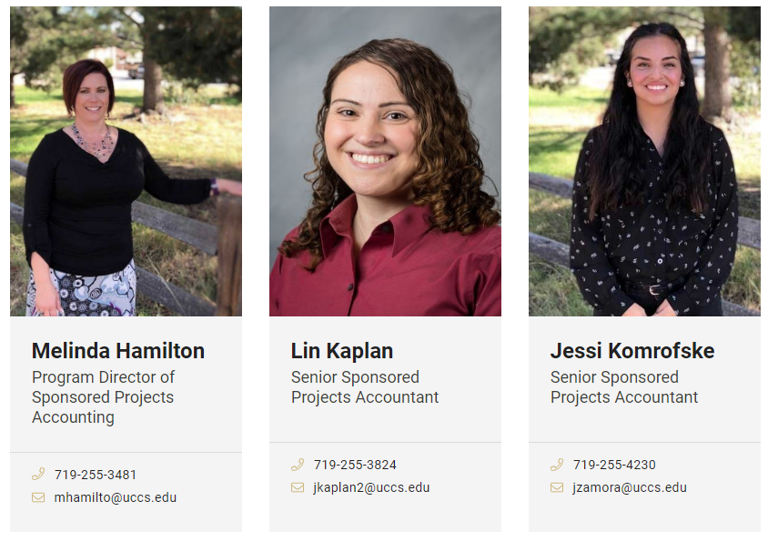
UCCS Sponsored Projects Team

Slide 8
Colleges/Units Supported by SPA

Slide 9
PI Duties
Conduct research
Oversight, compliance, and allowability of expenses and anything grant related
Should review monthly expenditure reports to ensure this
Submitting timely technical reports (if any on grant)
For specific PI Roles and Responsibilities see Policy 900-001
Campus Research Policy 900-001
Other PI Resources
https://osp.uccs.edu/handbook

Slide 10
Admin Duties
Send monthly expenditure reports to PI
Serves as the second line of defense in terms of compliance and allowability of expenditures based on sponsoring agency regulations
Should also review monthly expense reports
Submits invoices from subrecipients (if any)
Funding distributions, see Salaries & Wages

Slide 11
Allowable Expenses – Tests of Allowability
Allowable
Items not restricted by federal regulations, award terms, or university policies
Reasonable
Costs reflect what a prudent person would pay and is necessary for the completion of the project
Allocable
Allocate costs based on usage, effort FTE, etc. cannot just allocate an expense to a project with the most budget

Slide 12
Allowable Expenses – Tests of Allowability
Treated Consistently
If an expense is charged to the lab and tech shop supplies account code, a similar expense should be treated the same
Timely
Expenses can only be incurred during the performance period of your sponsored project (between start and end date)
If expenses need to be incurred before start date reach out to OSPRI office for pre-award approval
Reference https://www.ecfr.gov/current/title-2/subtitle-A/chapter-II/part-200/subpart-E

Slide 13
Allowable Expenses
If you have an expense that is questionable reach out to your Sponsored Projects Accountant
It is better to charge the expense correctly the first time then to perform a cost transfer later
Link to Direct Cost Charging Guidance for examples of ambiguous expenses
Direct Cost Charging Guidance

Slide 14
Examples of Ambiguous Expenses
Travel booked before end date, but taking place after the end date
Food (Official Functions)
Treat as unallowable unless outlined in proposal
No alcohol!
Membership Fees
Allowed if required to attend conference or performance on the grant
Administrative salaries
Rarely allowable
Notes:
Travel (conferences) should be lined out before in proposal and are usually to present results from project – all expenses need to be incurred within the project period (between start and end date)
Just because food was approved for one event does not mean that it is allowable somewhere else (eg. Food approved for conference does not mean food can be purchased for meetings)
Administrative salary is typically only allowable when grant work is particularly burdensome or a large amount of time or work will need to be dedicated to the project and can be specifically identified, any salary that someone is performing routine duties that would otherwise be the same for someone not on a grant than it cannot be “reimbursed”
If it is a membership that you would typically get like NCURA then it is not allowable but if it is a membership required for the project and/or a conference then it would be allowable

Slide 15
Cost Transfers
Definition:
is the transfer of a cost incurred initially on one university program and subsequently transferred to a sponsored project
It is best to avoid cost transfers by accurately charging sponsored projects, however, mistakes happen, and a cost should be transferred as soon as possible after the original transaction occurred

Slide 16
Cost Transfers Cont.
No later than 90 days after the end of the month of the original transaction
When this does happen a Cost Transfer Form is required to be attached to any JE’s with the PI’s signature and a PI statement is required for a PET (https://rmd.uccs.edu/uccs-controllers-office)
Use thorough descriptions for JE’s and PET’s (Payroll Expense Transfers) that would explain why the transfer was happening and would satisfy an auditor
This should be rule of thumb for any transfers, even less than 90 days

Slide 17
Salaries & Wages
Funding distributions need to be set up when receive new project and/or amendment
E.g. If individual is paid 20% from a sponsored project one of their other appointments needs to be reduced by 20% to prevent additional compensation and incorrect effort reporting
PeopleSoft Finance does not automatically feed to HCM, funding distributions are not automatically updated
If funding distribution is not updated, salary will go to Suspense ST, requiring a PET (in HCM) to correct
Notes:
Need to communicate with PPL (Pay Period Liaison soon to be HR Liaison) when notified of award or amendment if this is not one of your existing job duties already
VERY IMPORTANT to have distribution set up correctly in order to avoid cost transfers (PETs) and situations with additional pay where salary would need to be removed from project and onto a department ST
100% is 100%

Slide 18
Salaries and Wages Cont.
Institutional Base Salary (IBS)
2 CFR 200.430 (h)(2) – defines as the annual compensation paid by an IHE for an individual’s appt., whether that individual’s time is spent on research, instruction, administration, or other activities. Unless there is prior approval by the Federal awarding agency, charges of faculty’s salary to a Federal award must not exceed the proportionate share of the IBS for the period during which the faculty member worked on the award.
Sponsored project funds cannot be used to increase IBS
Notes:
Need to be consistent and go by strictest policy, which would be this Federal policy

Slide 19
Salaries & Wages Cont.
Summer salary for faculty working on grant 3/9 of AY Institutional Base Salary
E.g. If your PI earns $100,000 during AY ($100,000/9 = $11,111) allowing for up to $33,333 in the summer that includes grant pay and any and all other sources of funding
Additional compensation
Very rarely allowed
Notes:
Additional pay needs to be approved by the sponsor, summer salary for faculty working on a grant 3/9 of AY IBS. Additional compensation is anything that would increase the IBS during that allotted time
If your PI is receiving more than that then that would be considered additional pay
If you have any questions about your salary during your project’s life please reach out to SPA, if you have questions in the proposal stages please reach out to OSPRI

Slide 20
Salaries & Wages Misc.
Grant salaries and wages need to be treated consistently with university salaries and wages
E.g. Cannot give raises on a sponsored project based on the budget if the rest of the university is not receiving a raise
Different sponsors will have different rules
E.g. NSF will typically only allow two months of salary in any one year
Very important to know your sponsor’s guidelines!
Notes:
All normal procedures need to be followed just like normal university employees, e.g. performance reviews must be conducted in order to give

Slide 21
ePERs
Electronic Personnel Effort Reports
You are required to certify an ePER for every semester you are paid from a grant
It is required to complete the ePER training in SkillSoft
https://www.cu.edu/controller/epers-training Please watch for better understanding of ePERs
Notes:
If your ePER is reporting incorrectly please reach out to Melinda

Slide 22
ePERs
SPA Team sends out notifications and follow up emails for outstanding ePER certifications
Contact SPA regarding any questions concerning ePERs
Please certify in a timely manner

Slide 23
ePER Schedule
ePERs are due 120 days after the end of the semester
SPA closes out projects between 90-120 days of end date
Notes:
Summer technically starts mid-May and ends mid-August, contracts start in mid-August

Slide 24
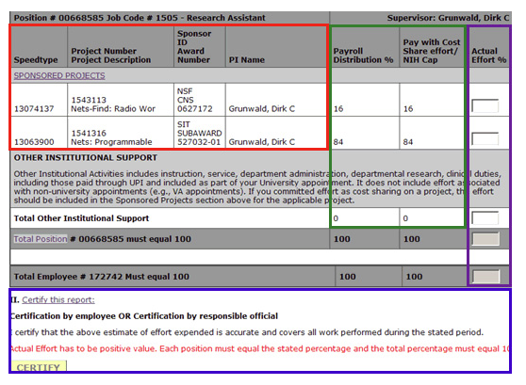
Process
The navigation to certify ePERs has changed with the new layout of the Portal
CU Resources Home tab (top center of portal) > Business Tools > ePERs
If you have employees that are unsure of the process, please fell free to share this video
https://www.cu.edu/controller/epers-training
There is a Step-by-Step Guide, Certifying ePER Process, on the UCCS Controller’s Office > Sponsored Projects Accounting page. The Actual Effort % column (purple) should match the Payroll and Cost Share columns (green)
Notes:
Even thought you may not have to certify in ePER it’s great information to have to help PIs

Slide 25
Cost Share
What is Cost Share?
The portion of the project costs not borne by the sponsor, but by the university
Mandatory Cost Sharing
Required by the sponsor as a condition of obtaining an award
Voluntary Cost Sharing
Resources offered by the university when it is not a specific requirement
Becomes a binding commitment of the project
Notes:
Try to avoid voluntary cost share, volunteering cost share does not make it more likely that you will receive an award

Slide 26
Cost Share
If your project has cost share be prepared to use a second ST (Fund 22 or 32) for budgeted cost share expenses
If cost share is salary, make sure funding distributions are set up to hit the CS ST
If cost share is “other”, make sure the purchaser in the department knows to charge expenses to the CS ST

Slide 27
Cost Share Continued
Your grants accountant will set up this ST and establish the budget and cash
If you want more information on this, there is a separate PowerPoint on Cost Share, please email jzamora@uccs.edu

Slide 28
Business Process
New Award
Sponsored Projects Accounting
Receive project set-up from OSPRI
Enter contract information into PeopleSoft
Communicate any special situations with the department

Slide 29
Business Process Cont.
Department will receive auto generated email with speedtype and other project information (budget, project #, etc.) day after ST is set up
Monitor expenses through life of project
Should be done at least on a quarterly basis to avoid cost transfers
Sponsored projects accountant will start closing out project 90 days after end date
Please communicate any extensions with OSPRI as soon as possible
Notes:
Please be aware of your sponsor’s rules in terms of requesting extensions

